Slide 1
oTree
platform to run interactive online experiments
written on Python
open source
based on Django framework
responsive – can be run in mobile browsers, tablets etc.
Materials and code for this workshop: | https://chapkovski.github.io/teaching/
My e-mail: | chapkovski@gmail.com
oTree support group: | https://groups.google.com/forum/#!forum/otree
oTree documentation: | http://otree.readthedocs.org/

Slide 2
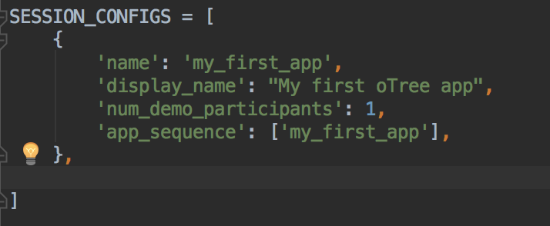
Let’s create our first oTree app
Create virtualenv
INSTALL OTREE: pip install –U otree
Check version: otree --version
otree startproject my_first_project
otree startapp my_first_app
add app to settings
otree devserver 80
go to: http://127.0.0.1

Slide 3

Very brief introduction

Slide 4
Structure of oTree app
Pages
Page classes
page_sequence
Models
Constants
Player, Group, Subsession
App definition in settings.py
Displaying logic
Data processing

Slide 5
Data processing: first intro
Models: where the data is stored (Player, Group, Subsession models)
Field types
doc, verbose_name, max_min, choices and other field properties

Slide 6
Anatomy of an oTree Page
Page creation:
class definition
template
When/if/for whom it is shown:
position in page_sequence
is_displayed method
What is shown:
vars_for_template method
What to do next:
before_next_page method

Slide 7
Methods of an oTree Page
BEFORE page is shown:
is_displayed (should return True if page is to be shown)
vars_for_template
AFTER page is shown:
before_next_page

Slide 8
GIT
Git init
git add .
git commit –m ‘Commit message’
git add remote origin <LINK_TO_GIT>
git push origin master
rolling back: git checkout <COMMIT_ID> .
git stash
git pull origin master
More info: http://rogerdudler.github.io/git-guide/

Slide 9
Heroku
create git first!
heroku create <APP_NAME>
heroku addons:create heroku-redis
git push heroku master
heroku run otree resetdb
heroku config

Slide 10
Guess game: description
A player has an endowment.
Random number is generated within certain limits
A player has to guess. The closer is the guess to a real number the larger is the profit.
Two fields: what is guessed, and a player’s decision
Three screens:
Intro: instructions
Decision with instructions
Results

Slide 11
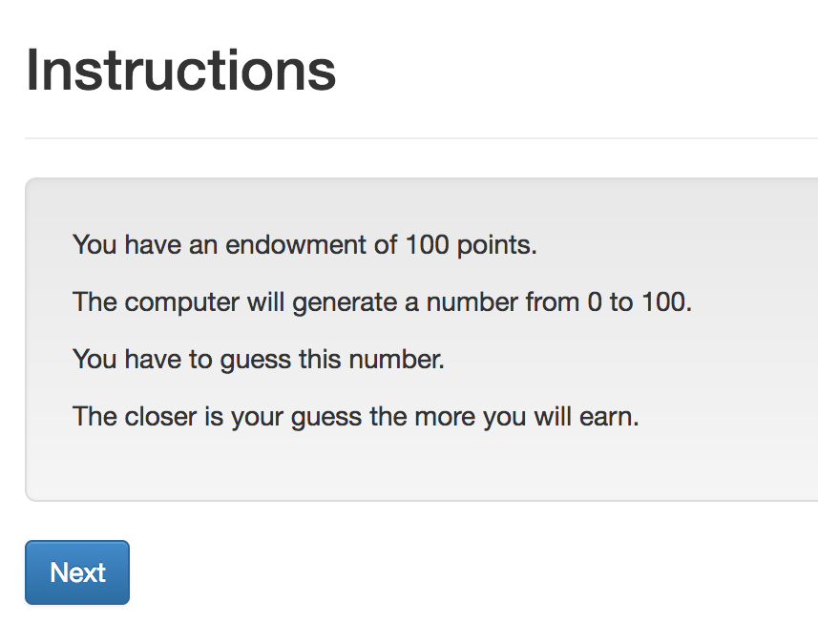
Guess game: screen 1

Slide 12
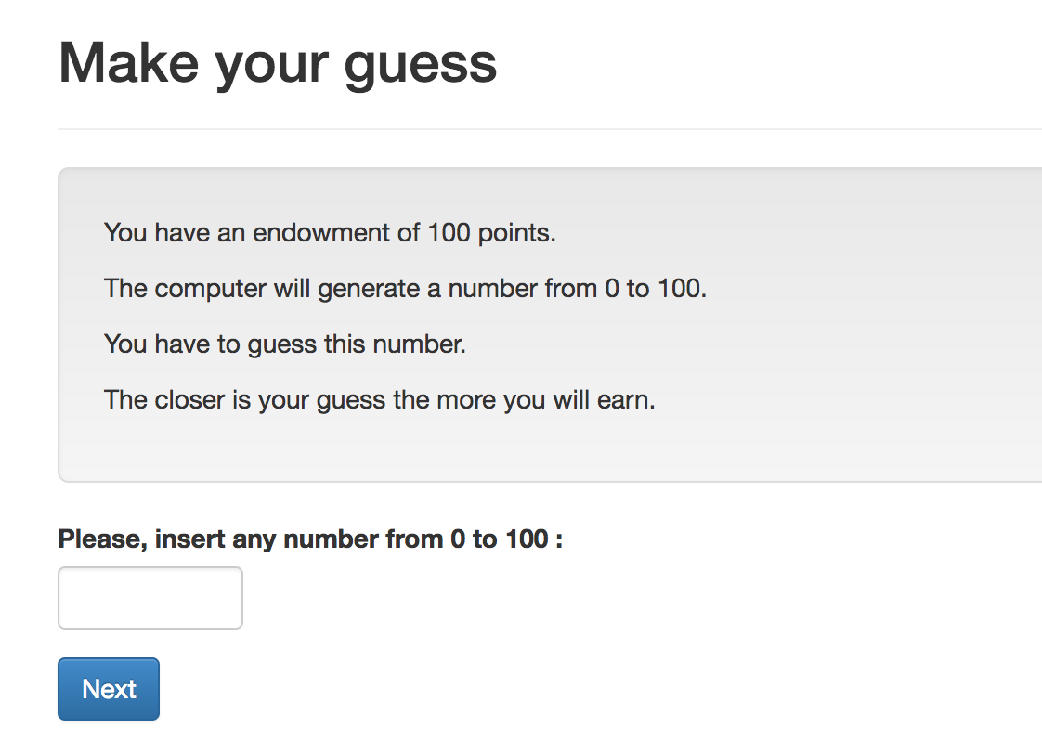
Guess game: screen 2

Slide 13
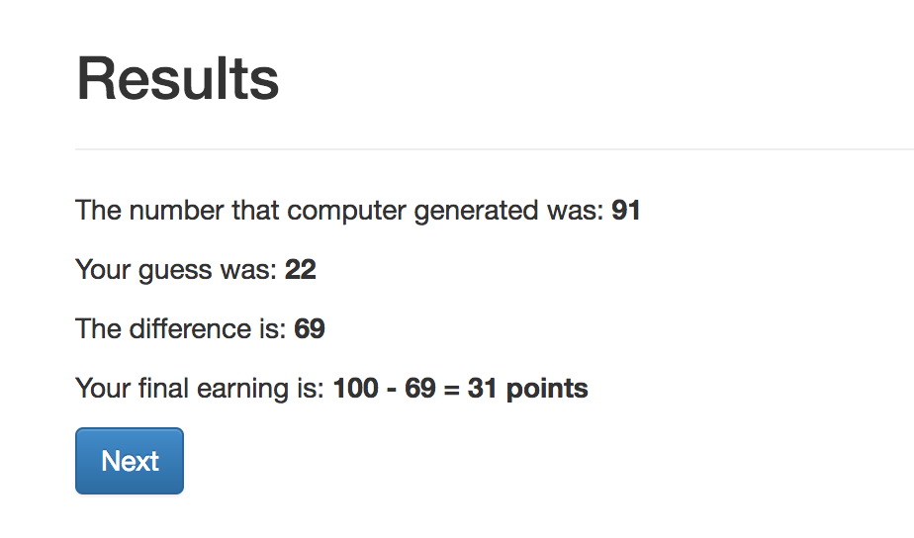
Guess game: screen 3

Slide 14
Guess game - Models
Creating new fields:
field_name = models.IntegerField()
Options:
field_name = models.IntegerField(
max=…,
min=…,
label=…,)

Slide 15
TODO: constants

Slide 16
Guess game: Models. Result:
class Player(BasePlayer):
toguess = models.IntegerField(min=Constants.minguess,
max=Constants.maxguess,)
guess = models.IntegerField(min=Constants.minguess,
max=Constants.maxguess,)

Slide 17
Guess game: Views
Creating new page
Class NameOfThePage(Page):
pass
page_sequence
page_sequence = [NameOfThePage]
By default name of the template corresponds to the page name!

Slide 18
Guess game: Views. Built-in functions
Built-in functions of pages:
”Normal” page:
def is_displayed(self):
return (True/False)
def vars_for_template(self):
return {'var': var}
def before_next_page(self):
…

Slide 19
Guess game - Templates
{% extends "global/Page.html" %}
{% load static otree %}
{% block title %} YOUR TITLE HERE {% endblock %}
{% block content %}
YOUR CONTENT HERE
{% endblock %}

Slide 20
Templates: using variables
In a template you can access variables defined in vars_for_template of the specific page:
{{ var }}
You can also use lists and dictionaries
You can also access any variable in Constants, Player, Group…
{{ player.payoff }}

Slide 21
Guess game - Templates
to include another file (for example instructions):
{% include 'path_to_file/name_of_file.html' %}
to make ‘Next button’:
{% next_button %}

Slide 22
Guess game: Views. Intro

Slide 23
Intro: How to do it?
Models.py: Constants:
endowment
minguess
maxguess
Intro.html:
in {% block content %}:
to refer to the constant: {{ Constants.endowment }}
Case sensitive!
No calculations! It is not Python!

Slide 24
Intro: Results:
{% extends "global/Page.html" %}
{% load staticfiles otree_tags %}
{% block title %}Instructions{% endblock %}
{% block content %}
{% include 'guess/instructions.html' %}
{% next_button %}
{% endblock %}
WHY?

Slide 25
Pages.Decision

Slide 26
Views.Decision. How to do it?
Referring to models. field in pages.py:
class Decision(Page):
form_model = 'player'
form_fields = ['guess']
referring to a field in a template:
{% formfield player.guess %} OR {{form}} or {% formfields %}
Generating random number:
class Intro(Page):
def before_next_page(self):
toguess = random.randint(Constants.minguess, Constants.maxguess)
self.player.toguess = toguess

Slide 27
Views.Resuts

Slide 28
Pages.Resuts. How to do it?
in pages.py: Decision page:
class Decision(Page):
...
def before_next_page(self):
self.player.set_payoff()
in models.py :
class Player(BasePlayer):
…
def set_payoff(self):
self.diff = abs(self.guess - self.toguess)
self.payoff = Constants.endowment - self.diff

Slide 29
Running the app
otree devserver
go to: http://127.0.0.1:8000

